Slide 1
MinGW

Slide 2
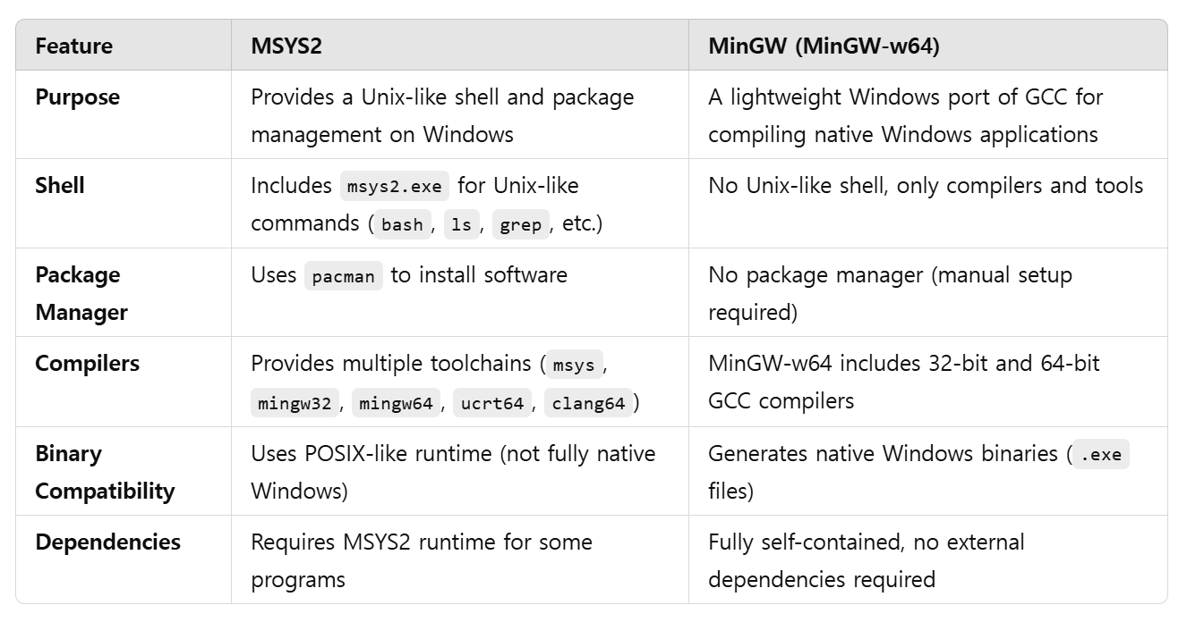
Overview MinGW
MinGW (Minimalist GNU for Windows) is a lightweight development environment for C, C++, and other programming languages on Windows.

Slide 3
Step 0. Download MinGW
Go to my github website: 🔗 https://github.com/prof-kweon/C-Language-Course/blob/main/LectureReference/Week1/mingwInstaller.exe
Click on "Download raw file".
Jump to Page 11

Slide 4
Step 1. Download MinGW
Go to the official MinGW-w64 website: 🔗 https://www.mingw-w64.org/
Click on "Downloads".
Under the Windows section, select "Mingw-w64-builds".
Download the latest MinGW-w64 installer for Windows.

Slide 5
Step 2. Install MinGW
Run the downloaded MinGW-w64 installer (mingw-w64-install.exe).
In the setup wizard, select:
Version: Latest stable version.
Architecture:
Select x86_64 (for 64-bit Windows)
Select i686 (for 32-bit Windows)
Threads: win32 or posix (choose win32 for better compatibility).
Exception Handling: sjlj or seh (choose seh for 64-bit, sjlj for 32-bit).
Choose an installation directory (e.g., C:\MinGW or C:\mingw-w64).
Click Install and wait for the installation to complete.
Click Finish.

Slide 6
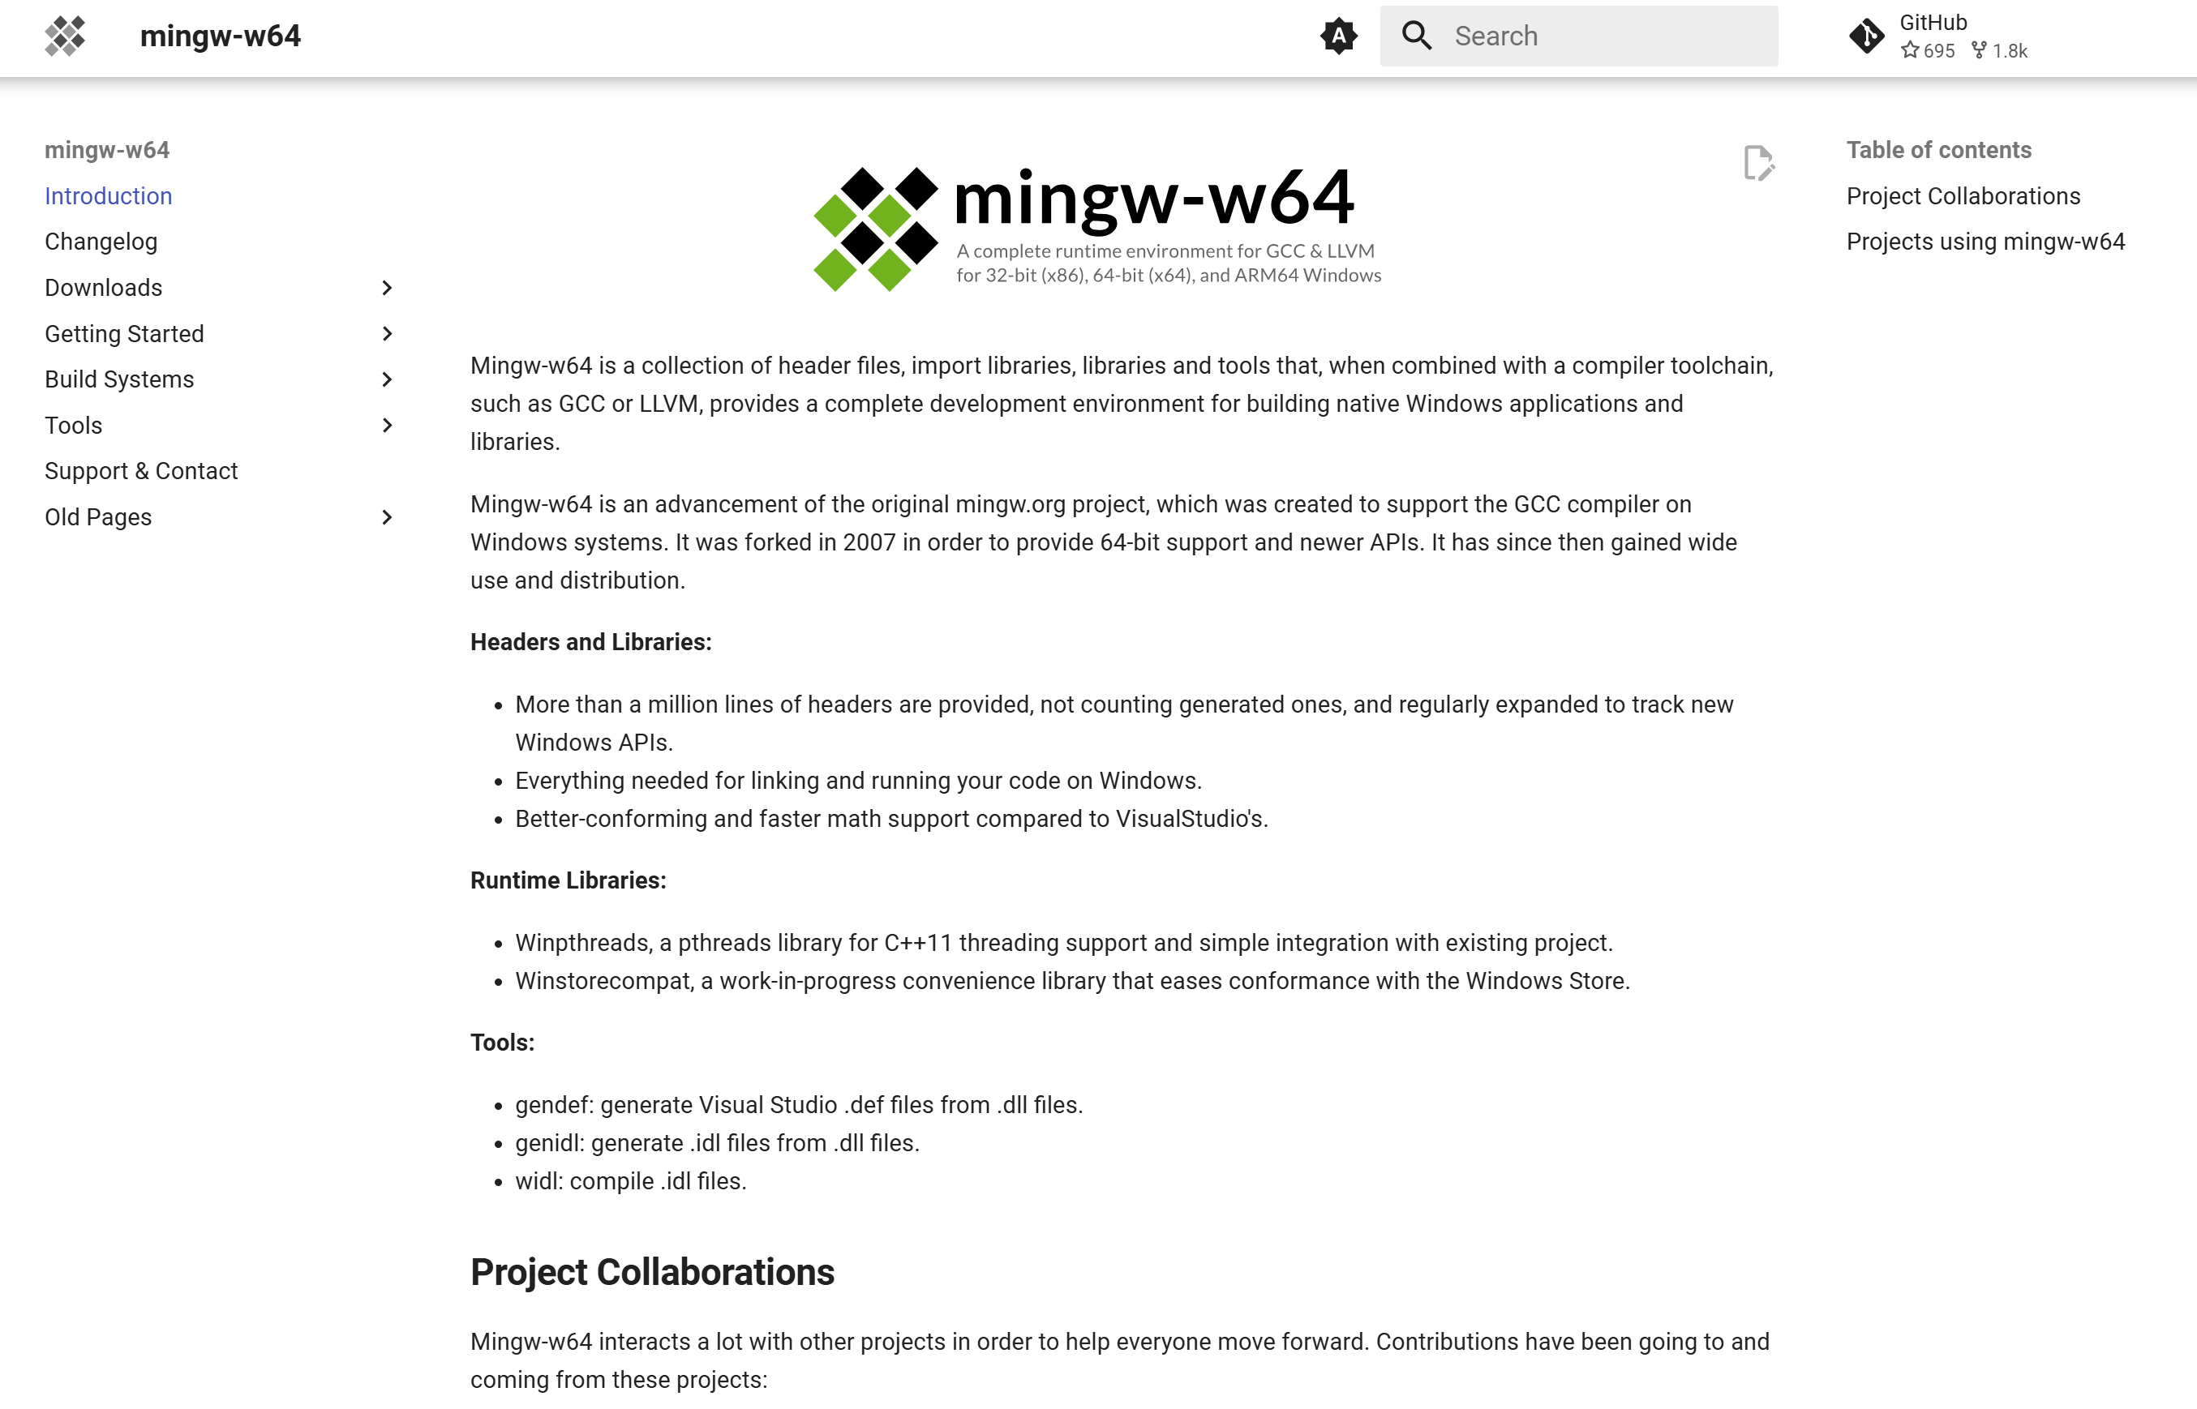
Step 2. Install MinGW
https://www.mingw-w64.org/

Slide 7
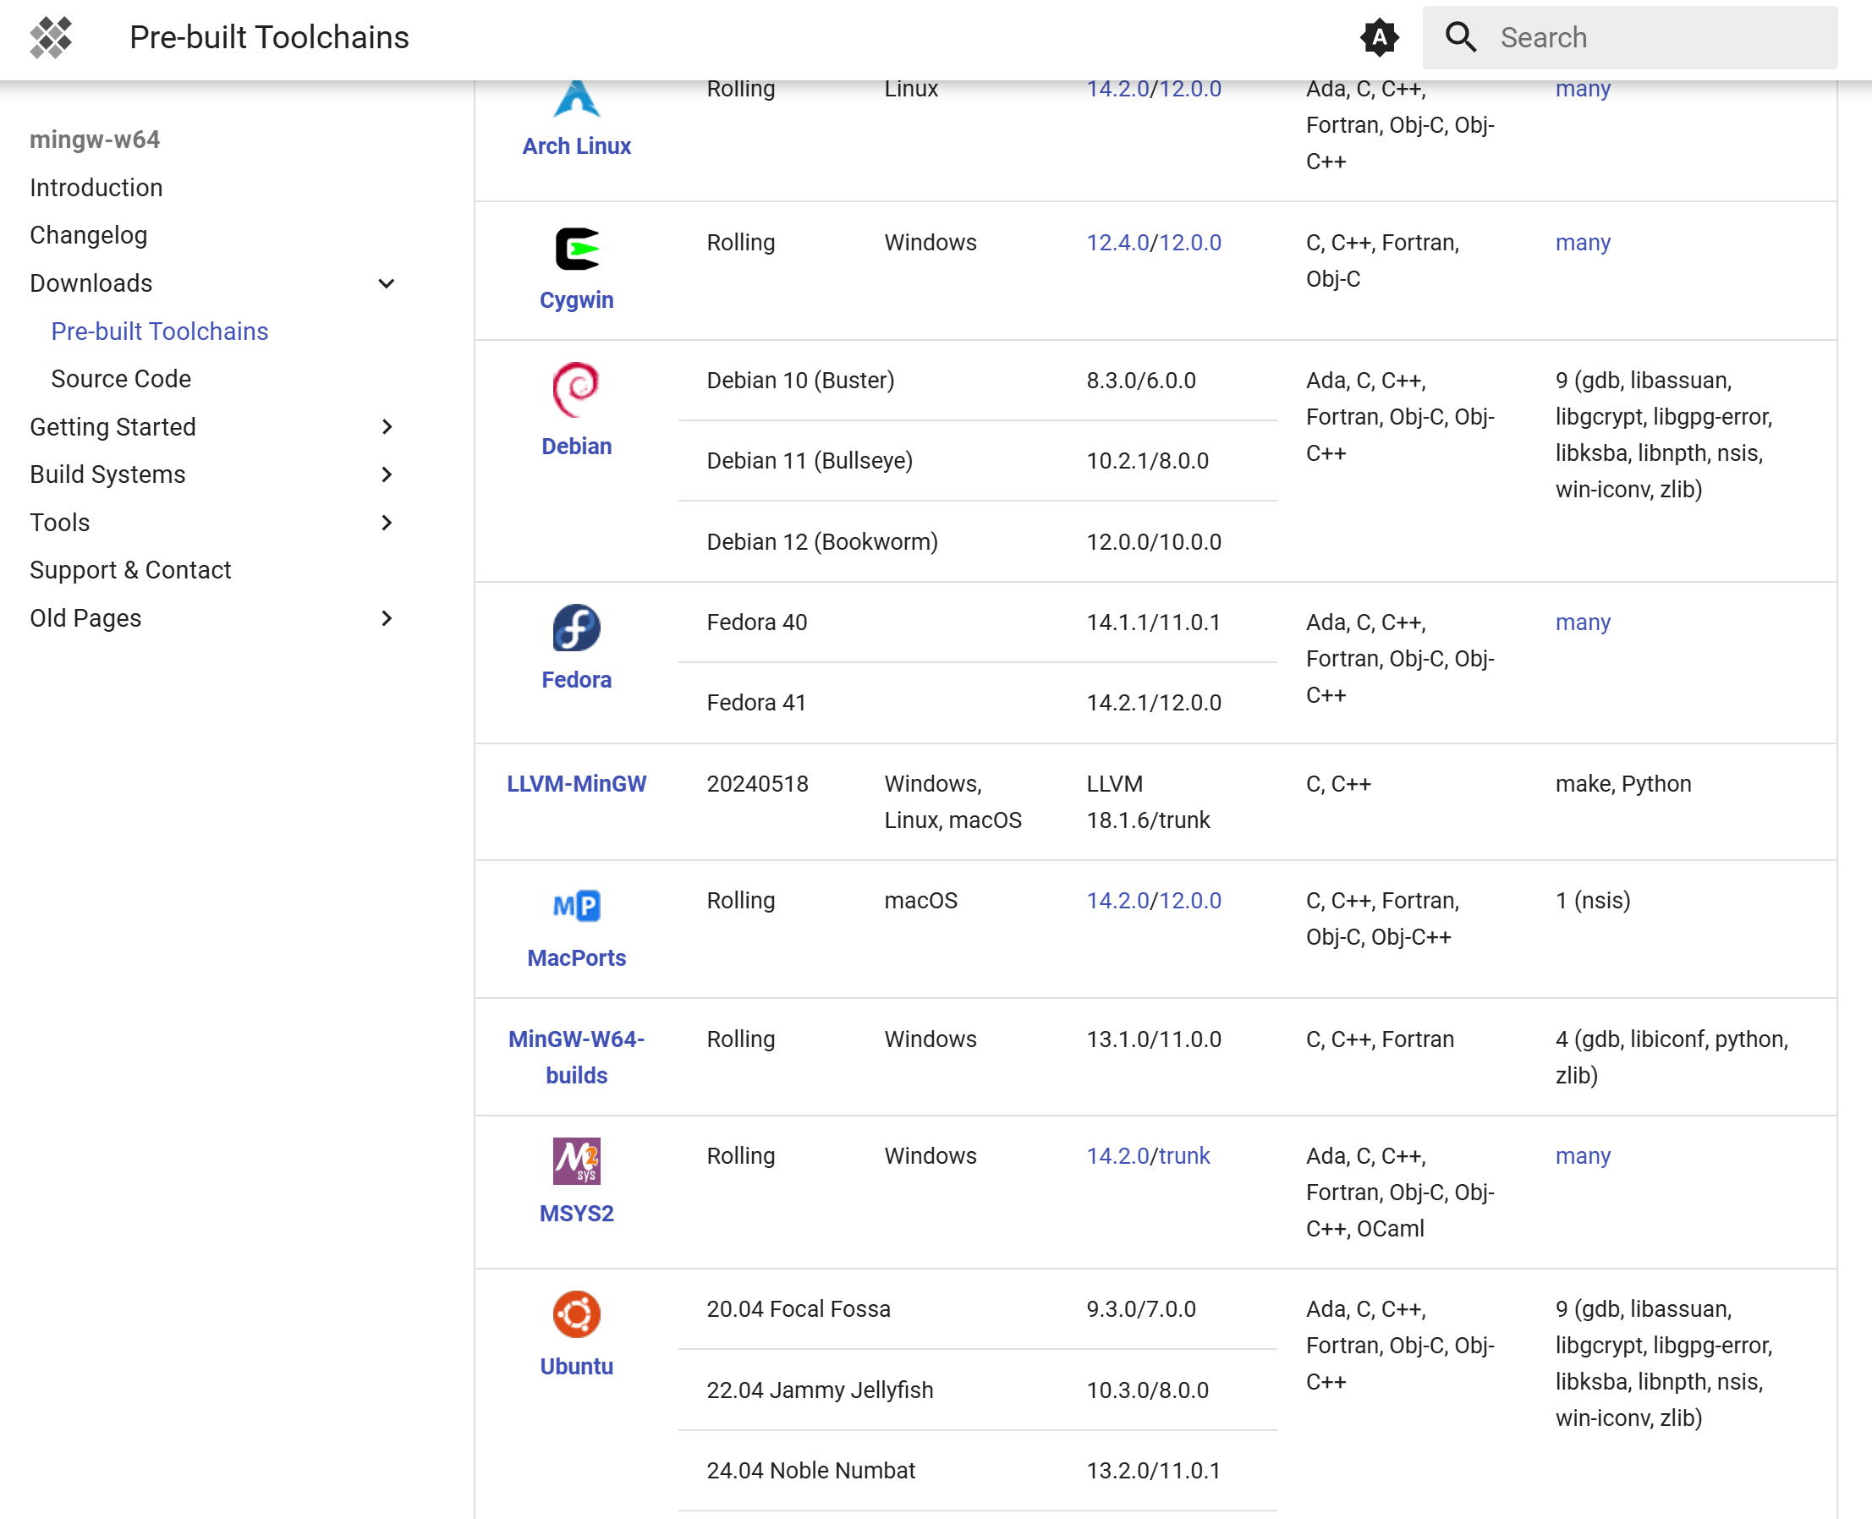
Step 2. Install MinGW
Download → Pre-built Toolchains

Slide 8
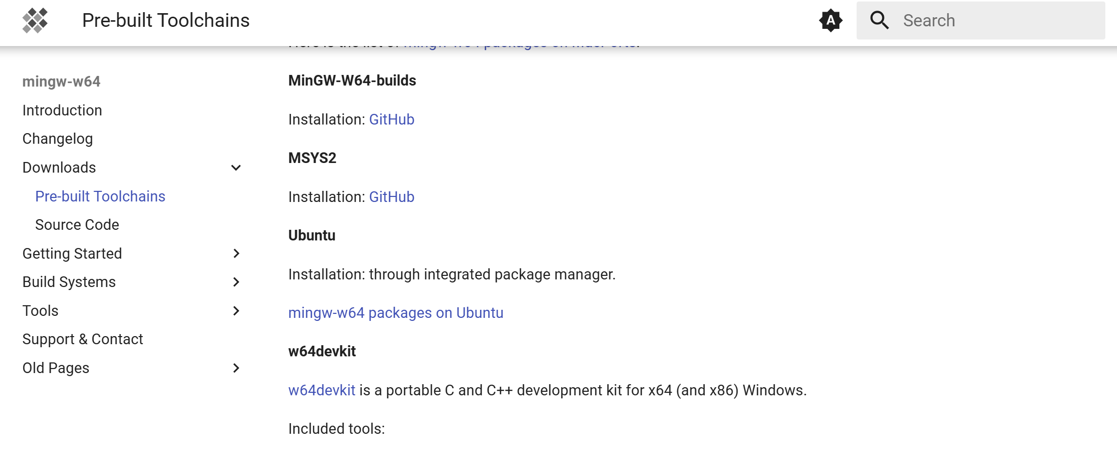
Step 2. Install MinGW

Slide 9
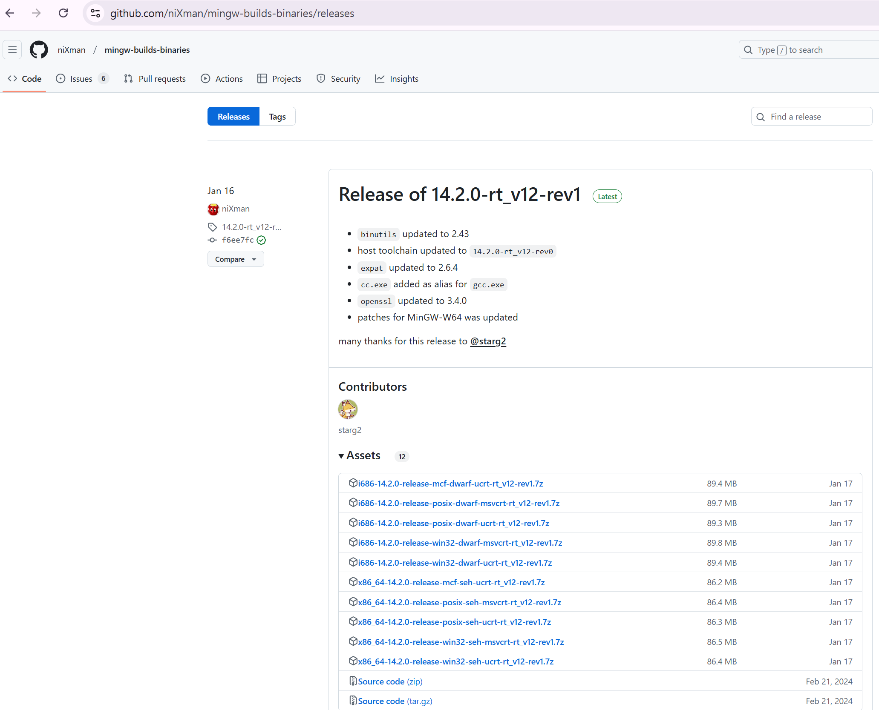
Step 2. Install MinGW
niXman/mingw-builds-binaries

Slide 10
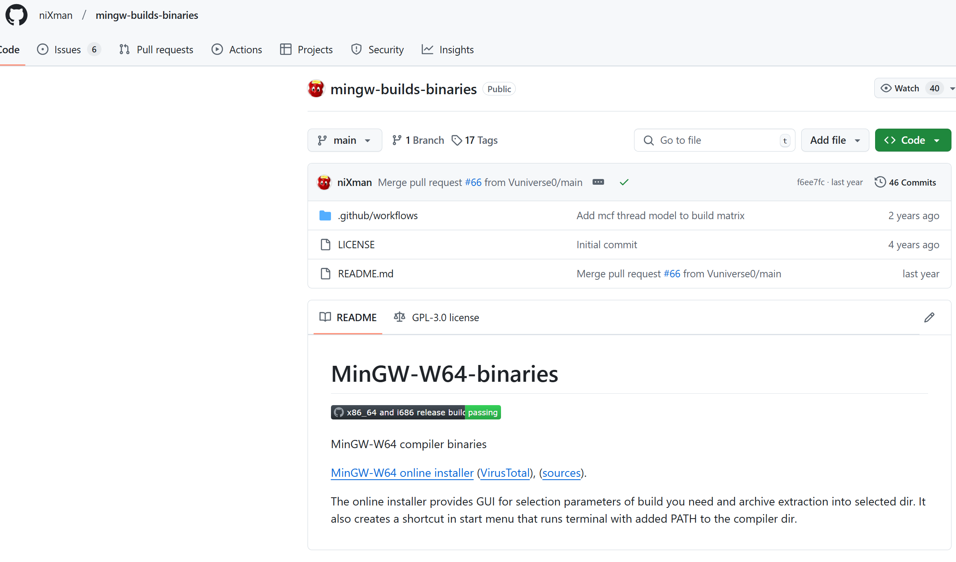
Step 2. Install MinGW
MinGW-W64 online installer

Slide 11
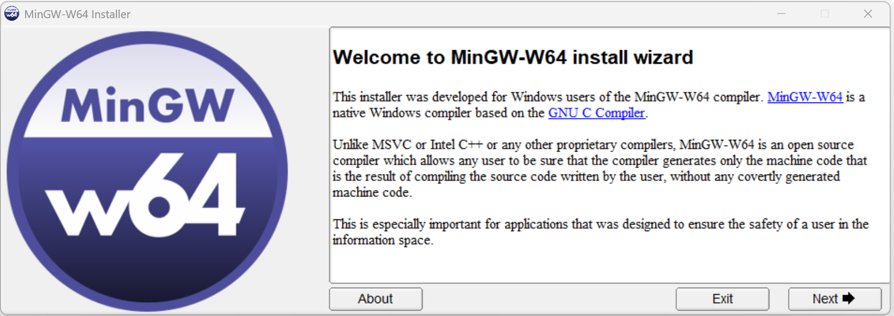
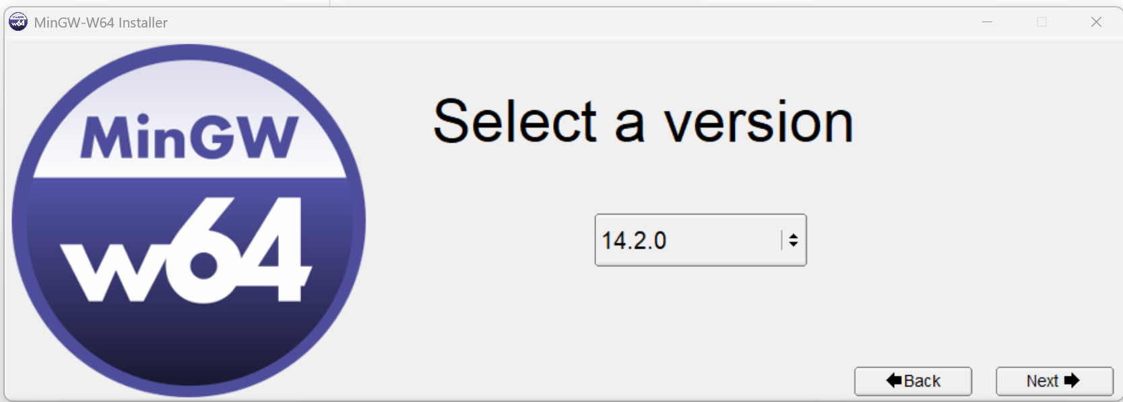
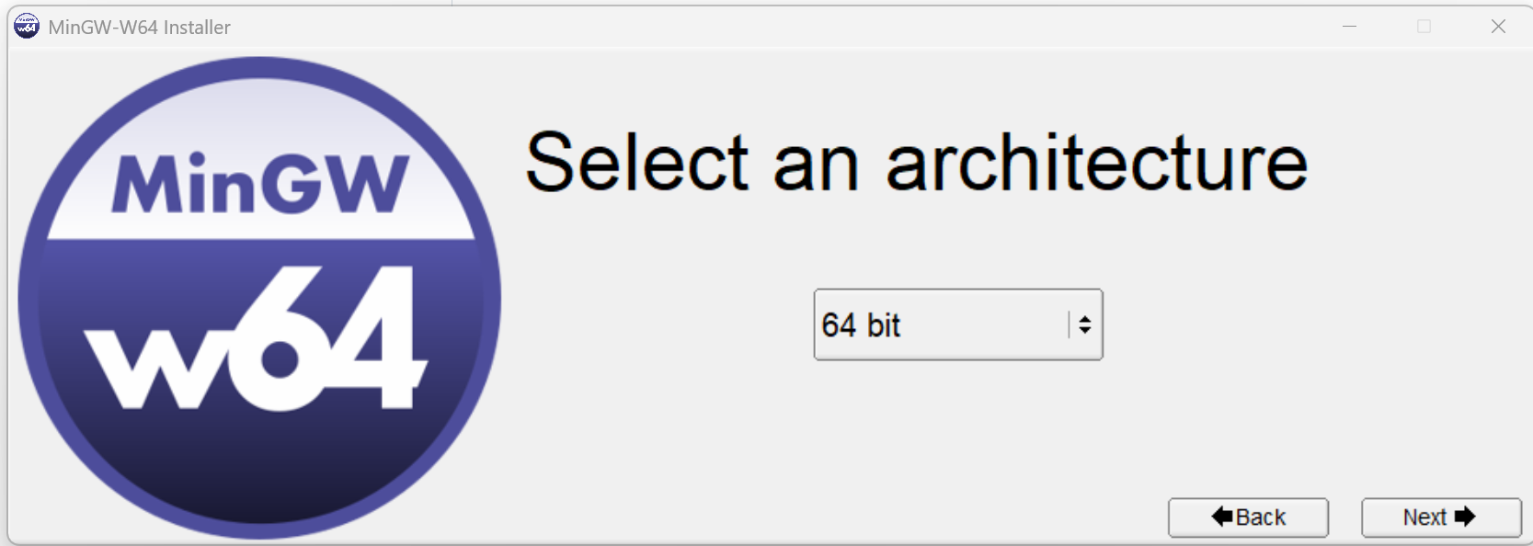
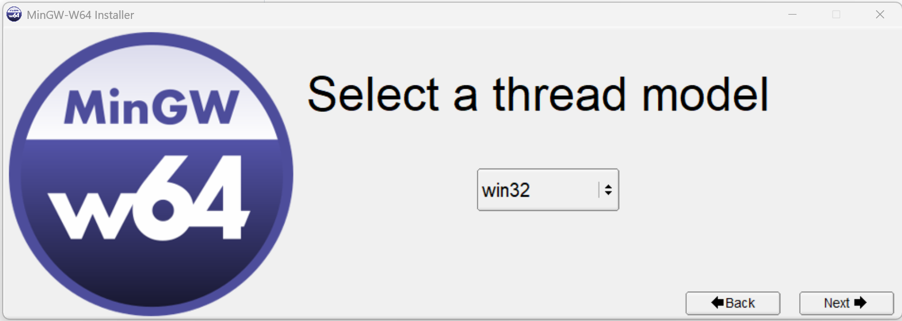
MinGW-W64 install wiazrd
1. Next
3. Choose the highest version
3. Choose 64 bit
3. Choose win32

Slide 12
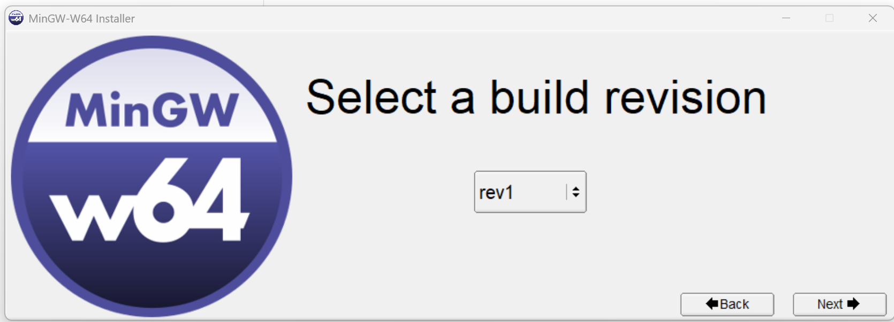
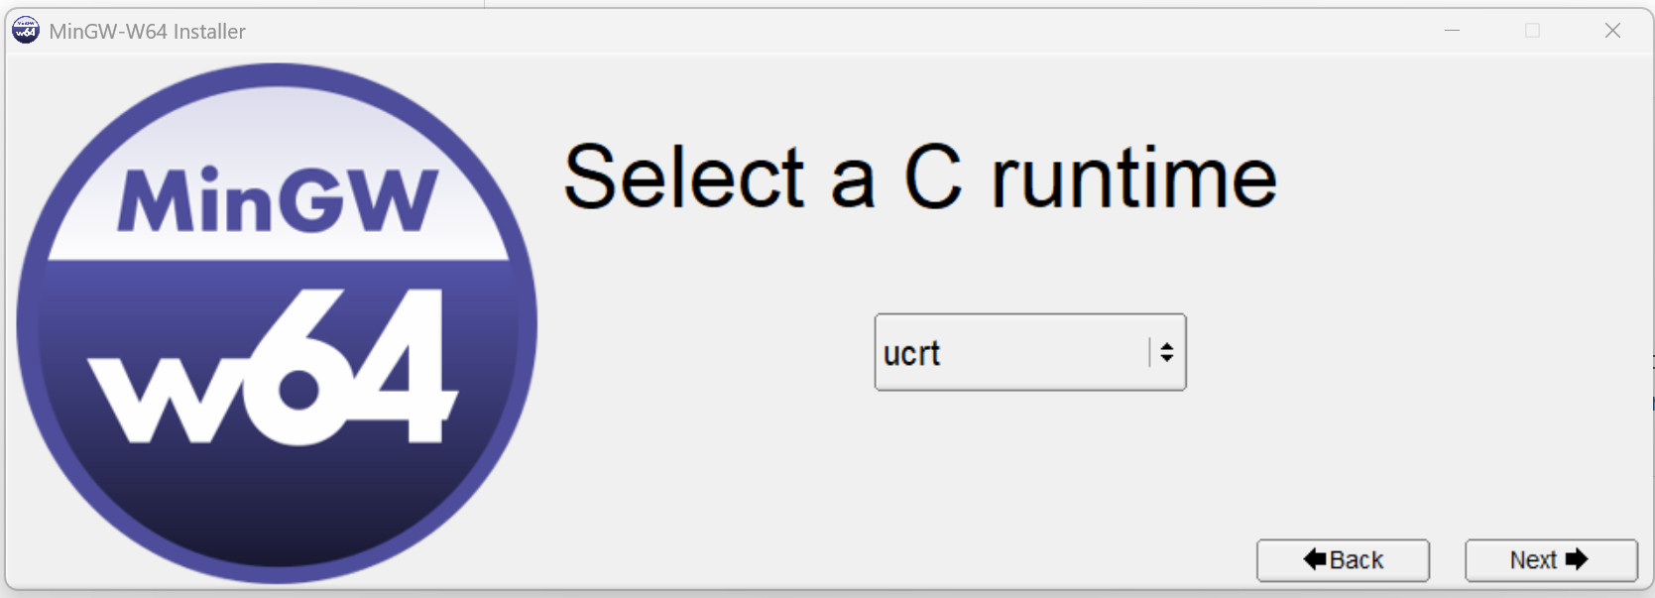
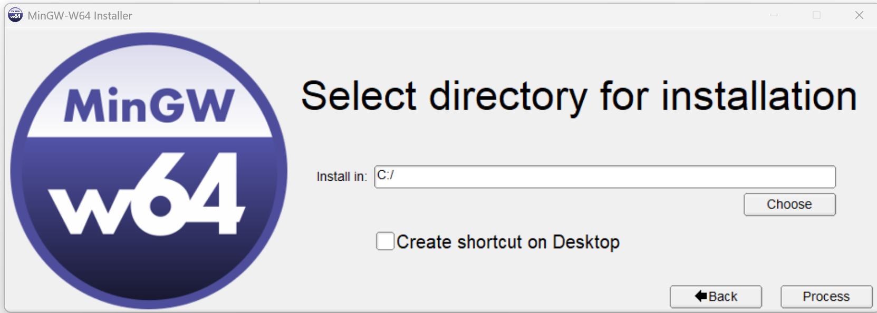
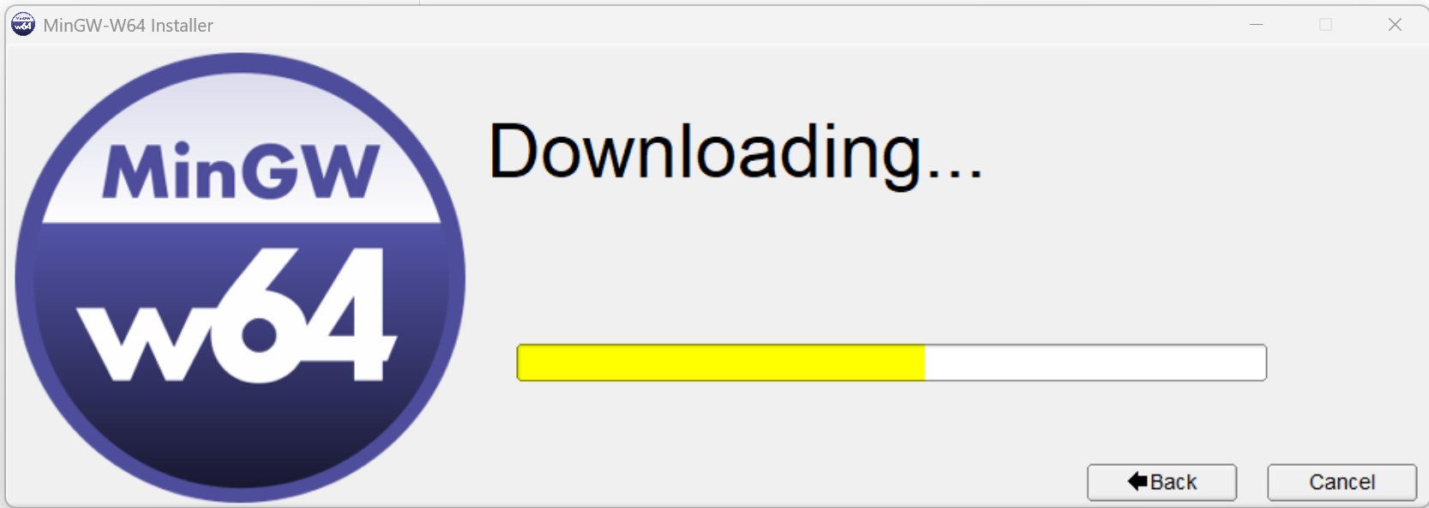
MinGW-W64 install wizard
5. Choose rev1
6. Choose ucrt
7. Press “Choose” and type c:\
8. Wait for finish

Slide 13
Step 3: Add MinGW to System PATH
To use MinGW from the command line, you need to add it to the system PATH.
Open File Explorer and navigate to your installation directory
(e.g., C:\MinGW\bin).
Copy the bin folder path (e.g., C:\MinGW\bin).
Open Control Panel → System → Advanced system settings.
Click on Environment Variables.
Under System Variables, find and select Path, then click Edit.
Click New and paste the MinGW bin path (e.g., C:\MinGW\bin).
Click OK to save and close all windows.

Slide 14
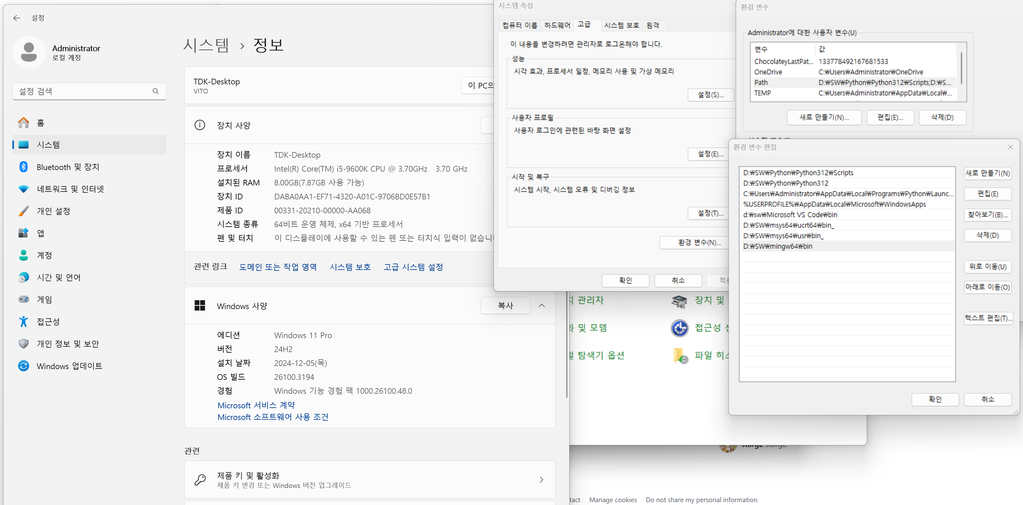
Control panel → System → Advanced system options → Environment Variables → Select Path →Edit → New → “c:\mingw64\bin
Step 3: Add MinGW to System PATH

Slide 15
Step 4: Verify the Installation
Open Command Prompt (cmd) or PowerShell.
Type the following command and press Enter:
gcc --version
3. If MinGW is installed correctly,
you should see output like:
gcc (MinGW-w64) 14.2.0

